Slide 1
Agri Crop Zone Analysis (ACZ) & Advisory Validation 2019 - 20
District Level Orientation Sessions for Kharif 2019

Slide 2
Overview
Validation of data for 2019 – 20 season wise

Slide 3
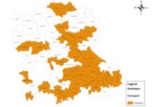
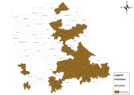
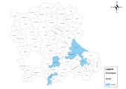
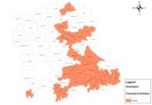
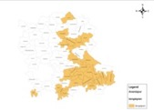
Agro Crop Zone Analysis (ACZ) - Overview
Rainfall Pattern
Crop Planning Model
Goals
Water Balance
Maximize Economic output
Sustainable Ground Water
Desired Crop Mix
Crop Phenology and Economic Value
Soil Types
Water Sources
(Canal, GW, Rainfed)
Current and Target MIP
Socio - Impact
Market Information
Provide the best cropping patterns for the location and ensures
Cropping pattern at Village level by soil type & source of irrigation
Drip and Micro Irrigation targets

Slide 4
Date of Sowing Advisories
AI based Sowing Advisories
Model for
Ground Nut, Cotton, Maize, Pulses etc.
Field Preparation Advisories
Crop Specific Water Requirement at Critical Stages
Weather Forecast Data
Sowing Advisories
Advisory Summary Reports
Soil Type
Soil Moisture
Benefits
Crop Specific Alerts to Field officers
Ensures maximum success rate of Crops
Considers the Dry Spells which may arise
Notes:
Benefits
Crop Specific Alerts to Field officers
Ensures maximum success rate of Crops
Considers the Dry Spells which may arise

Slide 5
Soil Moisture Stress Advisories
AI based Soil Moisture Stress Models for
Ground Nut, Cotton, Pulses, and other rainfed crops
Crop Water Need –
Next 10 Days
Crop Acreage
Weather Forecast Data
Identify Parts with Severe Dry Spell
Amount of Water Required for Saving the Farm
Rainfall and Weather
Satellite Based
A decision support dashboard that will raise advisory on
When should the irrigation be done, and build a irrigation schedule for water user associations
Amount of water required for irrigation
Nearby available water sources

Slide 6
Pest & Disease Forecast Advisories
AI based
Pest and Disease
Models for
Ground Nut, Cotton, Pulses, Rice and other major crops
Predict the pests that are likely to infest - Next one week
Date of Sowing of Crops
Weather Forecast Data
Look at the field Economic Threshold Levels (ETL)
Is the intervention necessary? If yes, mitigation advisory
Congenial conditions for pests
ETL levels, if likely infestation
Decision Support System that will predict the pests and diseases that are most likely to attack a particular farm
Looking at the ETL levels from field, the system uses predictive models to decide if intervention is needed

Slide 7
Login Screen

Slide 8
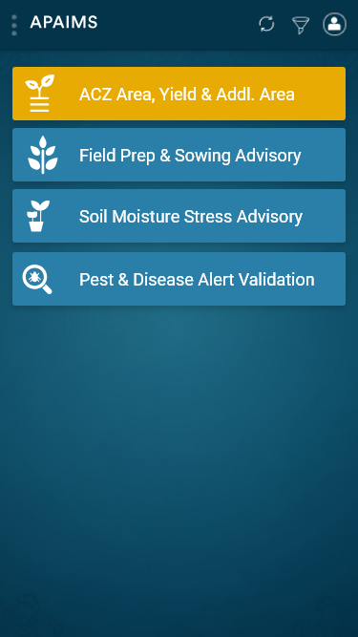
Module Selection

Slide 9
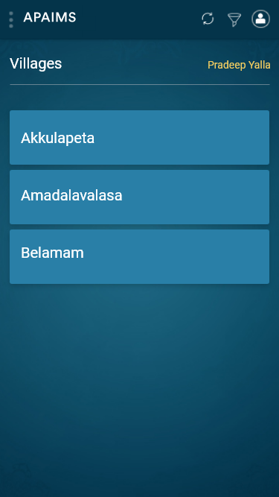
Village Selection

Slide 10
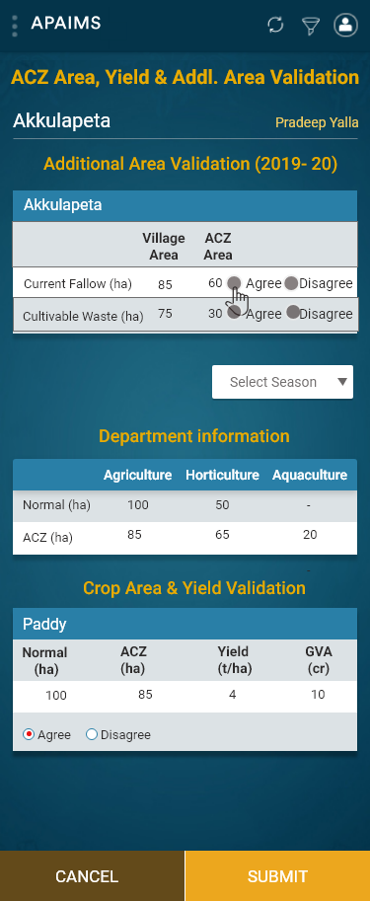
ACZ Area, Yield & Addl. Area Validation

Slide 11
ACZ AdditionalArea Validation Agree

Slide 12
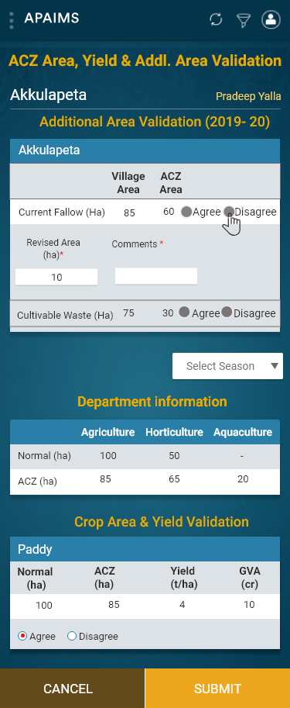
ACZ Additional Area Validation Disagree with Comments

Slide 13
Crop Area & Yield Validation

Slide 14
Crop Area & Yield Validation Agree

Slide 15
Crop Area & Yield Validation Disagree with Comments

Slide 16
Crop Area & Yield Validation Add new crop if missing

Slide 17
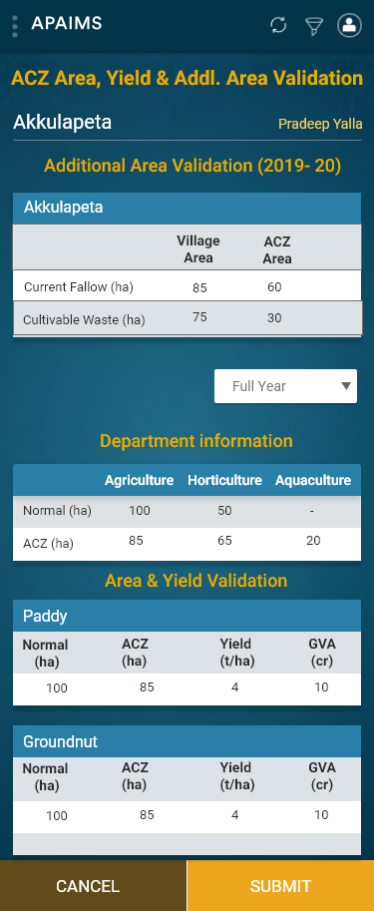
Crop Area & Yield Validation Full Year Summary

Slide 18
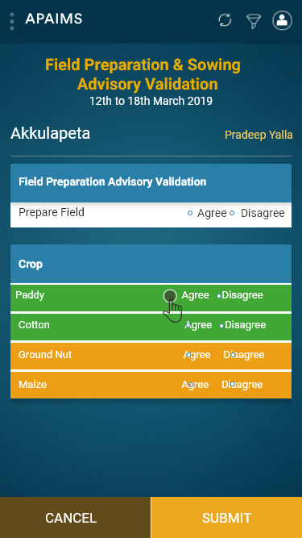
Field Preparation & Sowing Advisory Validation

Slide 19
Field Preparation & Sowing Advisory Validation Agree

Slide 20
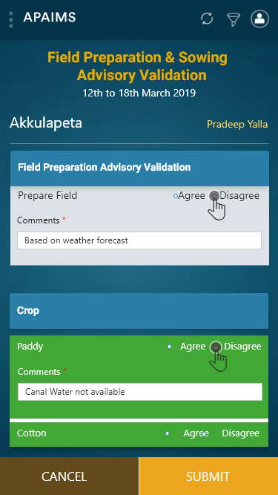
Field Preparation & Sowing Advisory Validation Disagree with Comments

Slide 21
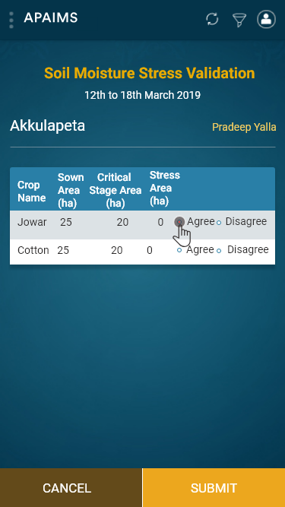
Soil Moisture Stress Advisory Validation Agree

Slide 22
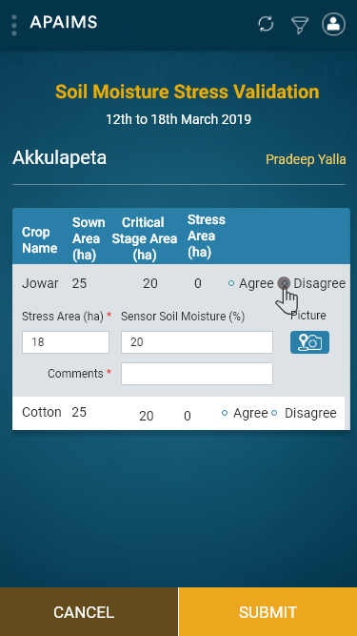
Soil Moisture Stress Advisory Validation Disagree with comments

Slide 23
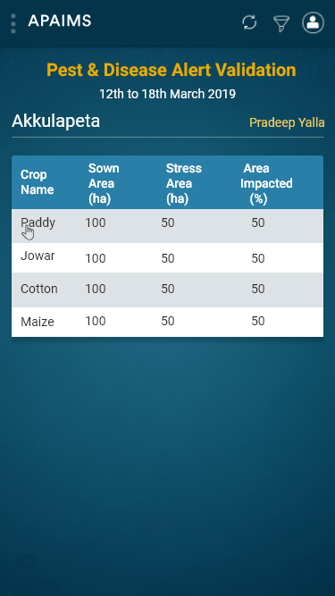
Pest & Disease Alert Validation screen

Slide 24
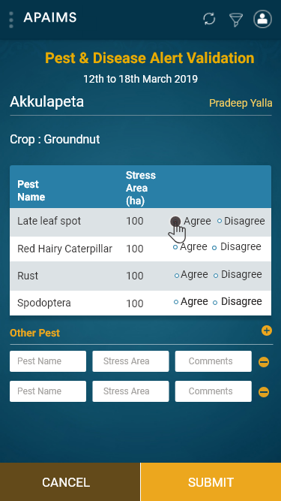
Pest & Disease Alert Advisory Validation screen Agree

Slide 25
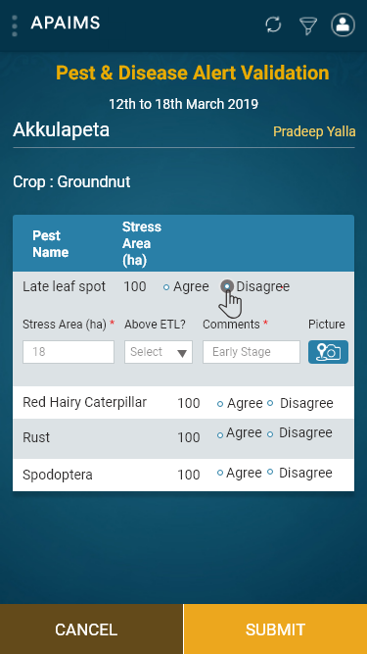
Pest & Disease Alert Advisory Validation screen Disagree with Comments

Slide 26
Process Flow
Updating MPEO and Agriculture office’s phone numbers
Validation within one week of access to app
Access will be provided one day after district orientation
Data entered at village level will be validated by concerned MAO and ADA
Mandal and district functionaries can validate village data in Web Portal within 1 week after MPEO exercise
The revised targets will be communicated by 22nd May 2019 for all the villages in the state

Slide 27
Contact Persons
Shravan Reddy – 63025 97817
Kurnool
Kadapa
Anantapur
Chittor
Prasanth – 91009 51660
Srikakulam
Vizianagaram
Visakhapatnam
East Godavari
West Godavari
Pradeep Yalla – 79935 35965
Krishna
Guntur
Prakasam
Nellore
Email ID: agri@vassarlabs.com

Slide 28
Thank You

Slide 29
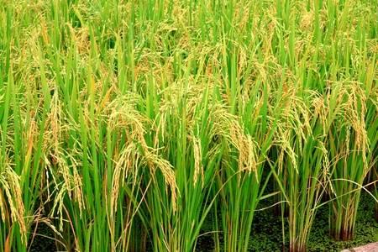
APAIMS Farmer Registration

Slide 30
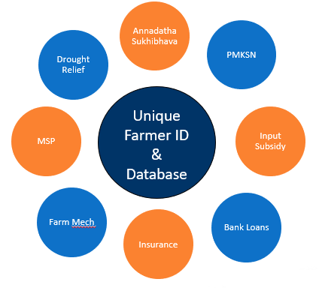
Farmer Registration Goals
Create Unique Farmer ID that can be used to identify all farmer details and benefits
Create authentic database of
Farmer details (Owner and Tenant)
Land details (owned and cultivation Land)
Crop and extent details

Slide 31
Farmer Registration Workflow
Farmer Registration using eKYC
(Owner/Tenant)
Automated Exception Mgmt
Public Display of List at Gram Panchayat
Issue CoC
Triaged Farmer database
Grievance Redressal by MAO and VRO

