Slide 1
DEPARTMENT OF AGRICULTURE
GOVERNMENT OF ANDHRA PRADESH
CROPPING INTENSITY & GVA
Sri N.Ch.Balu Naik, M.Sc(Ag)
Deputy Director of Agriculture
O/o C&DA, AP, Guntur
1

Slide 2
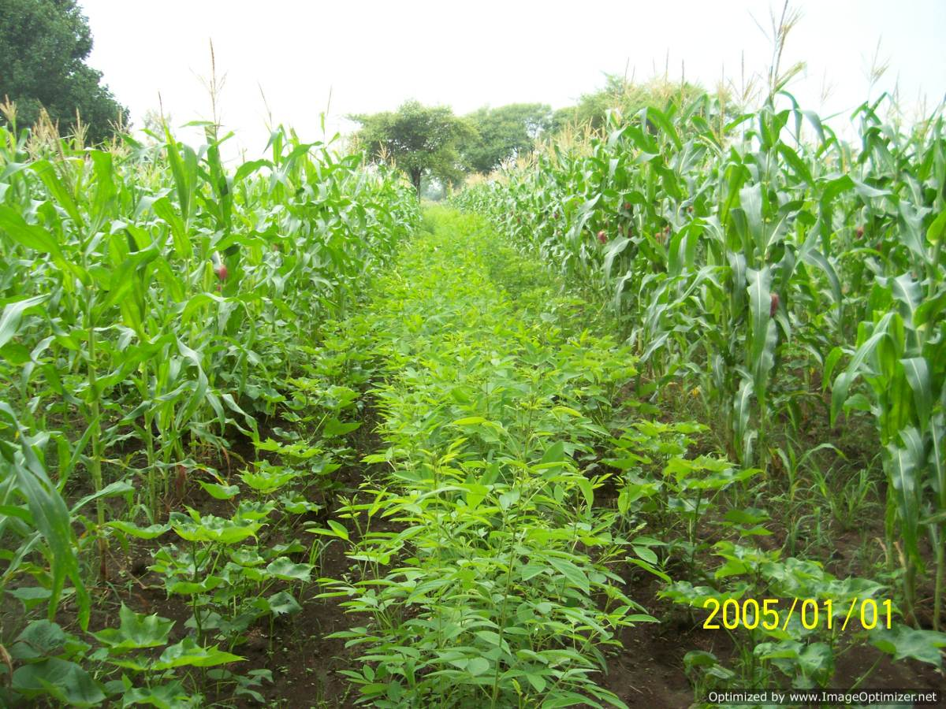
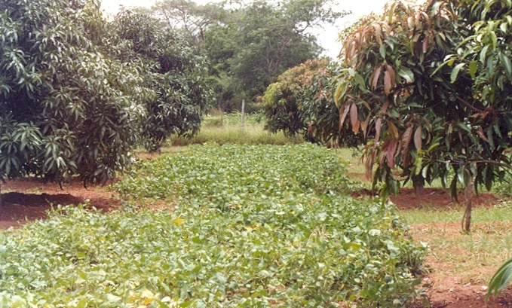
Cropping Intensity
S. No. | State | 2015-16 | 2016-17
1 | Punjab | 1.90
2 | West Bengal | 1.88
3 | Madhya Pradesh | 1.57
4 | Bihar | 1.45
5 | Assam | 1.43
6 | Rajasthan | 1.39
7 | Kerala | 1.30
8 | Tamil Nadu | 1.26
9 | AP | 1.24 | 1.25
10 | Karnataka | 1.20
11 | Telangana | 1.17
S. No. | District | Cropping Intensity
 |  | 2018-19 (Provisional) | 2019-20 (Target)
1 | West Godavari | 1.68 | 1.69
2 | East Godavari | 1.62 | 1.61
3 | Krishna | 1.52 | 1.51
4 | Srikakulam | 1.38 | 1.39
5 | Vizianagaram | 1.38 | 1.38
6 | Guntur | 1.31 | 1.30
7 | Visakhapatnam | 1.25 | 1.25
8 | Chittoor | 1.14 | 1.14
9 | Kurnool | 1.10 | 1.10
10 | YSR Kadapa | 1.14 | 1.13
11 | SPSR Nellore | 1.14 | 1.14
12 | Ananthapuramu | 1.06 | 1.06
13 | Prakasam | 1.04 | 1.04
Total |  | 1.25 | 1.25
2

Slide 3
District wise GVA Estimates for 2018-19 (AE) at Constant (2011-12) Prices
(Rs. in Cr)
CALCULATIONS
S.No | District | GVA
1 | Guntur | 4348
2 | West Godavari | 4327
3 | East Godavari | 3661
4 | Krishna | 3085
5 | Kurnool | 3075
6 | Prakasam | 2272
7 | SPSR Nellore | 1628
8 | Srikakulam | 1478
9 | Chittoor | 1309
10 | Vizianagaram | 1092
11 | Ananthapur | 1009
12 | Visakhapatnam | 921
13 | YSR Kadapa | 588
Total |  | 28792
1. Gross Value Output (GVO) in Crore
= Area * Productivity * Constant Price of
2011-12 / 1 Crore
(Where area in ha & productivity in Kgs/ha)
2. Gross Value Added (GVA) in Crore
GVA = GVO – Input costs
(Where inputs costs like seeds, fertilizers,
pesticides, irrigation, electricity, market
charges, diesel, maintenance & repairs etc)
3. Growth Rate in %:
2018-19 Growth rate %:
=(GVA value of 2018-19 - GVA value of 2017-18) *100/GVA value of 2017-18

Slide 4
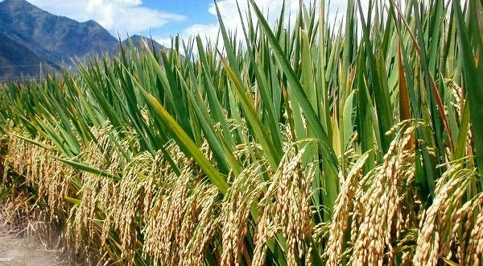
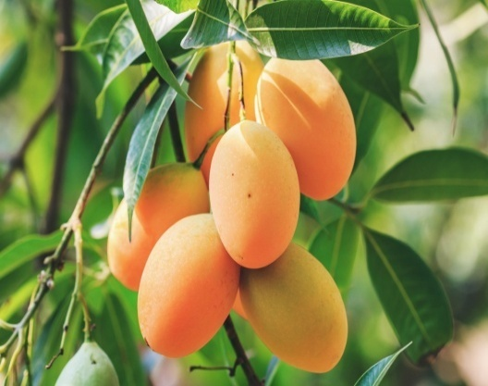
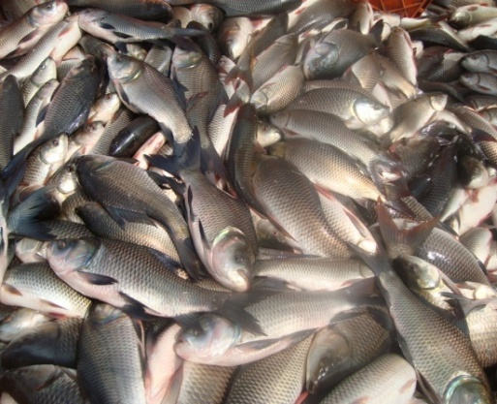
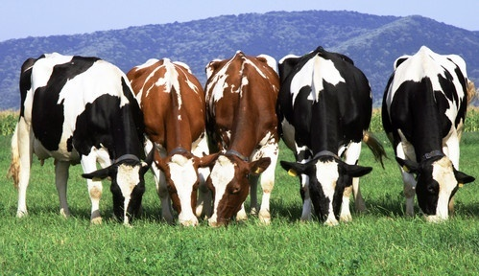
PRIMARY SECTOR GVA GROWTH RATE
S. No. | Sector | 2015-16 (RF: -30%) | 2016-17 (RF: -5.6%) | 2017-18 (RF: -14.4%) | 2018-19 (Target) | 2018-19 (II Qtr.) | India 2018-19 (II Qtr.)
1 | Agriculture | - 6.99 | 3.69 | 12.30 | 15.02 | -6.52 | 0.5
2 | Horticulture | 9.95 | 18.33 | 17.16 | 25.01 | 15.93 | 0.5
3 | Livestock | 7.96 | 14.91 | 13.05 | 20.02 | 15.34 | 8.0
4 | Fisheries | 41.71 | 42.57 | 30.84 | 30.22 | 22.36 | 8.4
5 | Forestry | -1.54 | 2.71 | 1.97 | 3.00 | 0.07 | 1.4
 | TOTAL | 10.88 | 14.91 | 17.76 | 22.66 | 17.18 | 3.8
As per advance estimates
4
4
4

Slide 5
Thank You
5
5

